Slide 1
Interest & Dividends
Pub 17, Chapters 7 & 8
Pub 4012, Tab D
(Federal 1040-Lines 8a-9b)
(NJ 1040-Lines 15a, 15b, 16)
Notes:
1

Slide 2
Federal Tax-Exempt Interest
Generally bonds issued by:
State/political subdivisions (county or city), District of Columbia, or U.S. possessions & political subdivisions
Savings bonds used for education (Form 8815)
NJ does not always follow Federal taxability rules for interest
See NJ GIT-5 for list
Notes:
2

Slide 3
When is Interest Tax Free?
Interest Type | Exempt From Federal Tax | Exempt From NJ Tax
Interest from U.S. Savings Bonds |  | √
Interest from NJ state/municipal bonds | √ | √
Interest from state/municipal bonds other than NJ | √
Notes:
3

Slide 4
TS - Taxable Interest Federal section \ Income \ Enter Myself \ Interest & Dividends (1099-INT, 1099-DIV) \ Interest Income, Form 1099-INT
Taxable interest
Early withdrawal penalty
Interest on US govt. bonds
Federal tax withheld
Foreign tax withheld (for foreign tax credit)
Interest on US govt. bonds tax exempt for NJ
Notes:
Everything from the 1099-INT is entered on this TaxSlayer screen except the tax-exempt interest shown in Box 8. That goes on a separate TaxSlayer screen
The taxable interest from this screen flows through to Schedule B & to 1040 Lines 8a Taxable Interest and then to NJ 1040 Lines 15a Taxable Interest
4

Slide 5
1099-INT Taxable Interest - TS Tips
Interest income in Box 1 is taxable for both Federal and NJ
Early withdrawal penalty in Box 2 is included in taxable interest for Federal, but can be offset by claiming an adjustment on Federal 1040 Line 30
TaxSlayer automatically subtracts penalty from NJ taxable interest, so Federal and NJ taxable interest amounts may differ
Total of taxable and non-taxable interest will be the same
Since interest on US government bonds is taxable for Federal, but not for NJ, must enter interest amount to be subtracted from NJ income
TaxSlayer will automatically create appropriate Foreign Tax Credit on 1040 Line 48 if foreign tax withheld in Box 6
Notes:
5

Slide 6
1099-INT Federal Tax-Exempt Interest
Federal tax-exempt interest shown in Box 8 must be entered on a different screen than Federal taxable interest
Enter in Federal section \ Income \ Enter Myself \ Interest & Dividends (1099-INT, 1099-DIV) \ Interest or Dividend Income \ Tax Exempt Interest Income, Form 1099-INT, Box 8 or 1099-DIV, Box 10
If any of the Federal tax-exempt interest is taxable for NJ (e.g. – bond interest from other states), must add a Taxable State Interest Item screen to enter the amount
Notes:
6

Slide 7
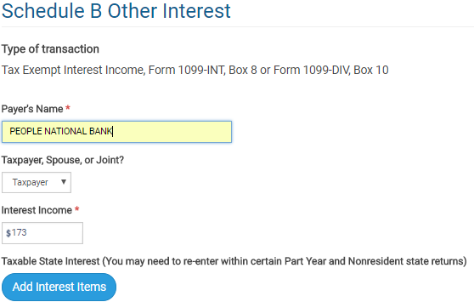
TS - Federal Tax-Exempt Interest Federal section \ Income \ Enter Myself \ Interest & Dividends (1099-INT, 1099-DIV) \ Interest or Dividend Income \ Tax Exempt Interest Income, Form 1099-INT, Box 8 or 1099-DIV, Box 10
Federal tax-exempt interest
Click if Federal tax-exempt interest is taxable for NJ
Notes:
Use this TaxSlayer screen to enter tax-exempt interest that is shown in 1099-INT Box 8
Info from this Interest screen flows through to 1040 Line 8b Tax-Exempt Interest and then to NJ 1040 Line 15b Tax-Exempt Interest
7

Slide 8
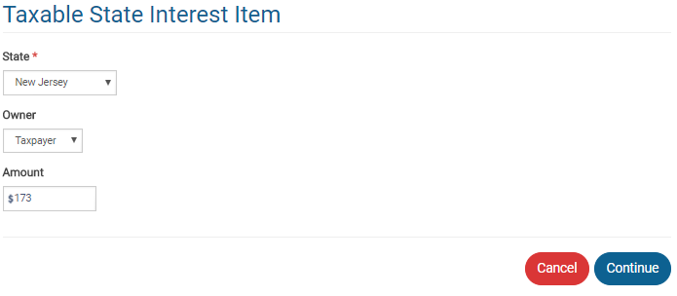
TS - Federal Tax-Exempt Interest that is Taxable for NJ Federal section \ Income \ Enter Myself \ Interest & Dividends (1099-INT, 1099-DIV) \ Interest or Dividend Income \ Tax Exempt Interest Income, Form 1099-INT \ Taxable State Interest Item
Federal tax-exempt amount that is taxable for NJ
Notes:
Use this screen to record any amount that is tax-exempt on the Federal, but taxable for NJ (such as bond interest from a state other than NJ)
8

Slide 9
1099-INT on Brokerage Statement
Summary of potentially many individual transactions
Only summary values need to be entered on TaxSlayer Interest screen
Use name of Brokerage as payer
Detail transactions backing up summary data are usually listed on later pages in statement
If there is a tax-exempt interest amount (Box 8), then that amount is tax exempt federally, but you may need to examine detail to determine how much is tax exempt for New Jersey
Tax-exempt mutual funds should have a breakdown of tax-exempt percentages by state

Slide 10
Dividends
Pub 4012 Tab D
Dividends
Part of the earnings of a corporation that is distributed to its shareholders
Unearned income
Ordinary and Qualified dividends segregated (different tax rates)
End-of-year tax statement:
1099-DIV Statement OR Brokerage Statement
Where to report?
Enter in Federal section \ Income \ Enter Myself \ Interest and Dividends (1099-INT, 1099-DIV) \ Interest or Dividend Income \ Dividend Income, Form 1099-DIV, Box 1
Flows through to Sch B & 1040 Lines 9a & 9b and NJ 1040 Line 16
Notes:
10

Slide 11
Exempt Interest Dividends from Mutual Funds
Tax exempt on Federal return
Taxability varies for NJ, depending on bonds held by fund (look at statement detail pages)
Interest attributable to Federal obligations (including P.R., territories, etc.) always tax exempt
Interest attributable to other states except NJ always taxable
Interest attributable to NJ bonds only tax exempt if fund is “NJ Qualified Investment Fund” (usually has NJ in name of fund)
Interest on NJ bonds held individually by taxpayer (not in a mutual fund) always tax exempt

Slide 12
TS – Entering Exempt Interest Dividends
Enter full amount of Federal Exempt Interest Dividends from Box 10 on Tax-Exempt Interest screen
Brokerage statement usually provides percentages of bonds in different categories (i.e. – Federal, each state). Apply those percentages to Federal Exempt Interest Dividends amount as appropriate
Add a Taxable State Interest Item screen
If Federal or multi-state fund, add all non-Federal amounts (including NJ amounts) as amount that is taxable for NJ
If fund is NJ specific, add only amount from states other than NJ as amount that is taxable for NJ

Slide 13
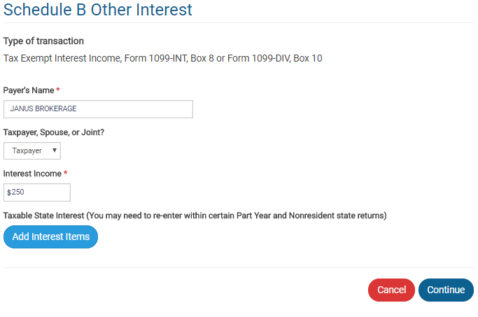
TS - 1099-DIV Exempt Interest Dividends Federal section \ Income \ Enter Myself \ Interest & Dividends (1099-INT, 1099-DIV) \ Tax Exempt Interest Income, Form 1099-INT, Box 8 or Form 1099-DIV, Box 10
Same screen used for tax-exempt
interest and exempt interest dividends
Exempt interest dividends for Federal
Click if any exempt interest dividends are taxable for NJ
Notes:
13

Slide 14
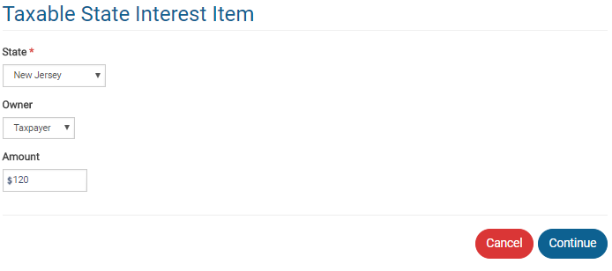
TS - 1099-DIV Exempt Interest Dividends That Are Taxable for NJ Federal section \ Income \ Enter Myself \ Interest & Dividends (1099-INT, 1099-DIV) \ Tax Exempt Interest Income, Form 1099-INT, Box 8 or Form 1099-DIV, Box 10
Federal exempt interest dividends
taxable for NJ
Notes:
14

